Slide 1
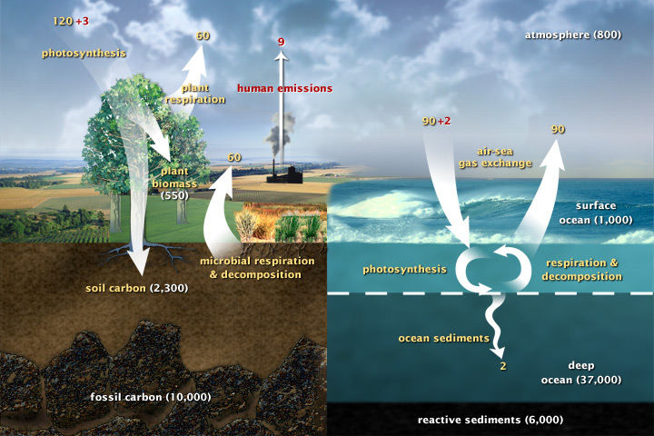
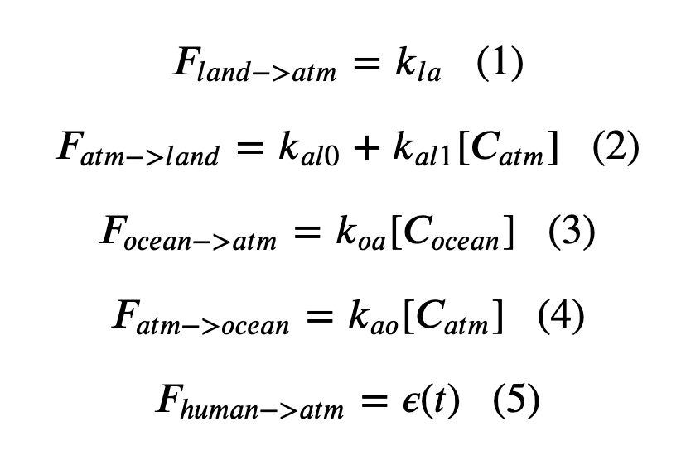
Cambio1.0
Euler’s method:
In a loop, we calculated fluxes

Slide 2
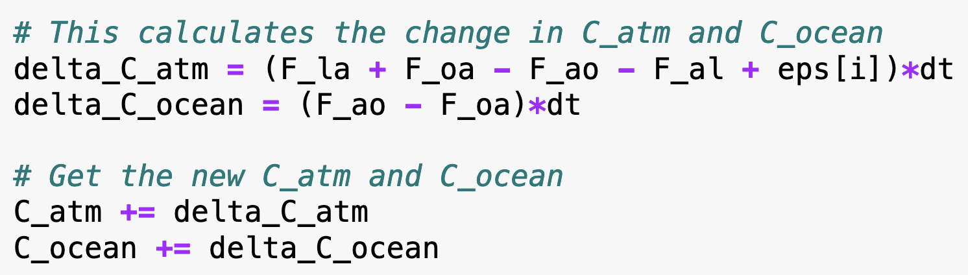
Cambio1.0
Euler’s method:
Then we calculated changes to the concentrations in the atmosphere and oceans

Slide 3
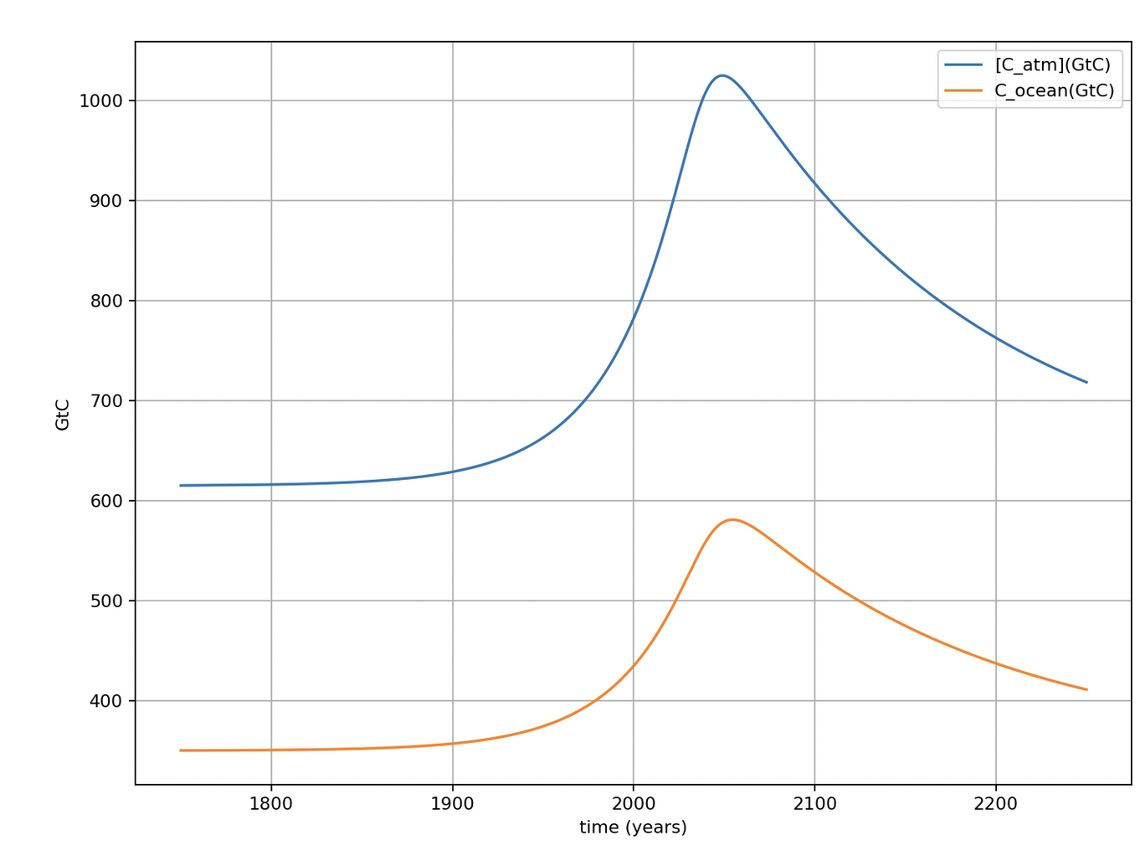
Amounts in the atmosphere and the upper ocean
615 GtC in air (pre-industrial)
Pre-industrial carbon amounts
350 GtC in upper ocean (pre-industrial)

Slide 4
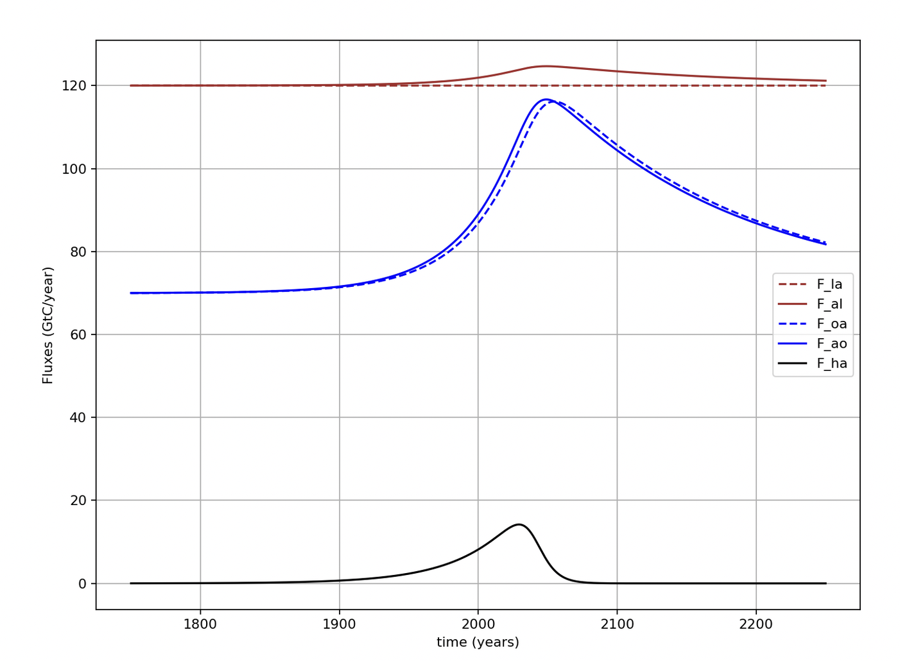
Clear that we’re modeling small differences between big numbers (fluxes)

Slide 5
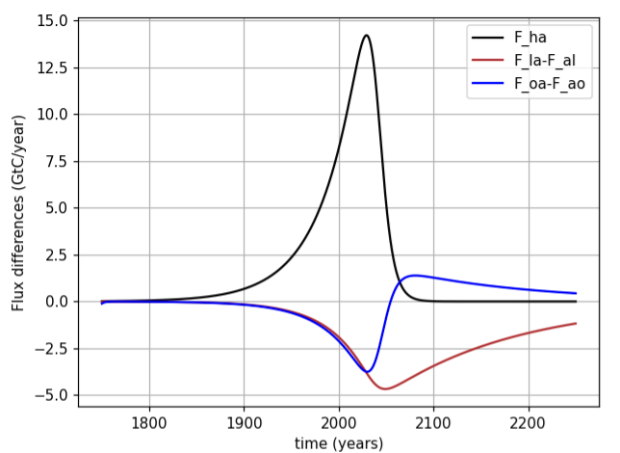
Right now (year 2023) it looks like net fluxes to land and oceans are about ¼ of anthropogenic flux to atmosphere
We can say that the sum of these sinks (about ½ of anthropogenic flux) is Earth’s ”free” ecosystem service

Slide 6
But oceans are more like a lending library
Oceans become a net source of carbon around mid-century
Peak net ocean-to-atmosphere flux

